Slide 1
Machine Learning

Slide 2
What is Machine Learning?
“Machine Learning is the science of getting computers to learn and act like humans do, and improve their learning over time in autonomous fashion, by feeding them data and information in the form of observations and real-world interactions.”

Slide 3
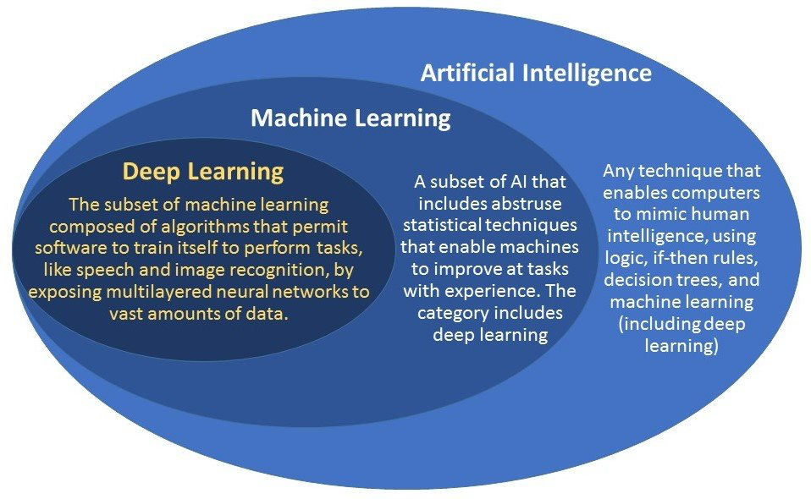
How Machine Learning Relates To Artificial Intelligence and Deep Learning

Slide 4
Artificial Intelligence
A non-human program or model that can solve sophisticated tasks. For example, a program or model that translates text or a program or model that identifies diseases from radiologic images both exhibit artificial intelligence.

Slide 5
Deep Learning
An artificial intelligence function that imitates the workings of the human brain in processing data and creating patterns for use in decision making

Slide 6
Examples of Deep Learning
Automated Driving: Automotive researchers are using deep learning to automatically detect objects such as stop signs and traffic lights. In addition, deep learning is used to detect pedestrians, which helps decrease accidents.
Aerospace and Defense: Deep learning is used to identify objects from satellites that locate areas of interest, and identify safe or unsafe zones for troops.
Medical Research: Cancer researchers are using deep learning to automatically detect cancer cells. Teams at UCLA built an advanced microscope that yields a high-dimensional data set used to train a deep learning application to accurately identify cancer cells.
Industrial Automation: Deep learning is helping to improve worker safety around heavy machinery by automatically detecting when people or objects are within an unsafe distance of machines.
Electronics: Deep learning is being used in automated hearing and speech translation. For example, home assistance devices that respond to your voice and know your preferences are powered by deep learning applications.

Slide 7
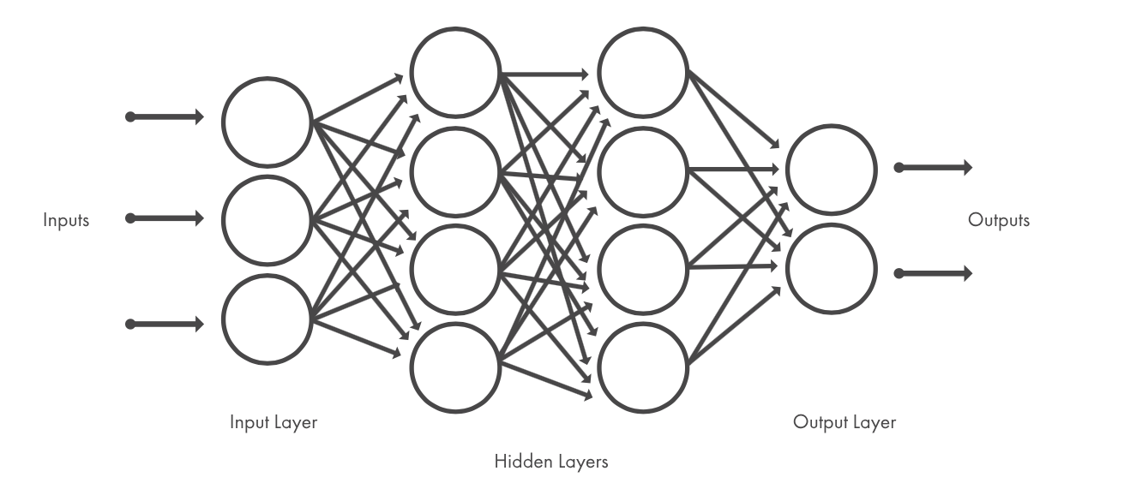
Deep Learning
Neural Network

Slide 8
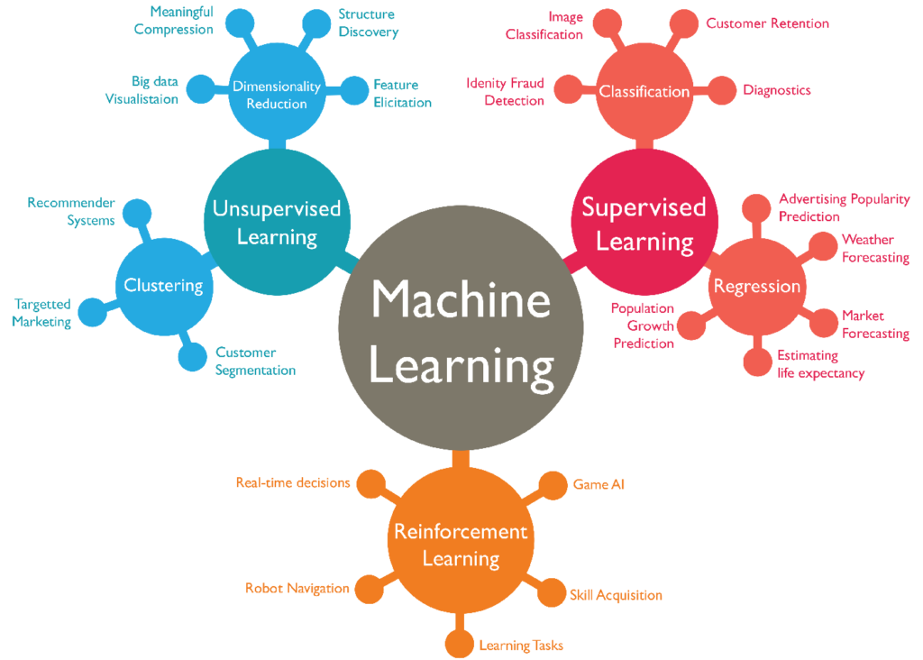

Slide 9
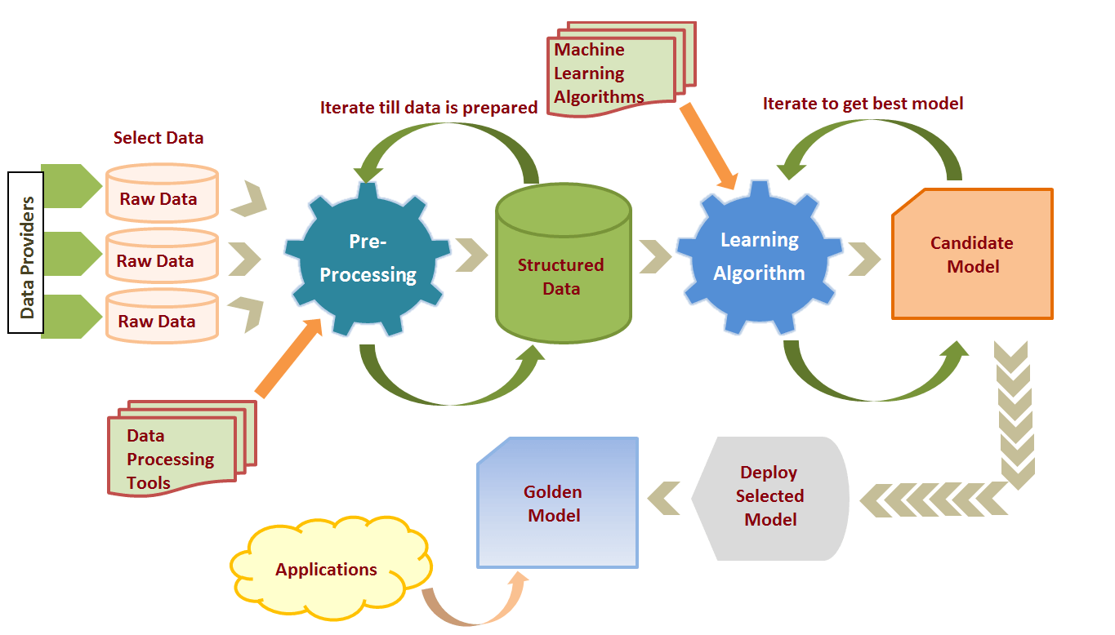
Simplified Machine Learning Process

Slide 10
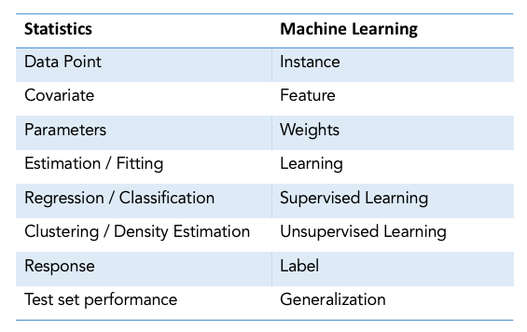
Vocabulary

Slide 11
Attribute
Synonym for feature. In fairness, attributes often refer to characteristics pertaining to individuals. An input variable used in making predictions.

Slide 12
Examples of Attributes/Features
In character recognition, features may include histograms counting the number of black pixels along horizontal and vertical directions, number of internal holes, stroke detection and many others.
In speech recognition, features for recognizing phonemes can include noise ratios, length of sounds, relative power, filter matches and many others.
In spam detection algorithms, features may include the presence or absence of certain email headers, the email structure, the language, the frequency of specific terms, the grammatical correctness of the text.
In computer vision, there are a large number of possible features, such as edges and objects.

Slide 13
Label
In supervised learning, the "answer" or "result" portion of an example. Each example in a labeled dataset consists of one or more features and a label.

Slide 14
Examples of Features and Labels
In a housing dataset, the features might include the number of bedrooms, the number of bathrooms, and the age of the house, while the label might be the house's price.
In a spam detection dataset, the features might include the subject line, the sender, and the email message itself, while the label would probably be either "spam" or "not spam."

Slide 15
Labeled Data
A labeled dataset has a meaningful “label”, “class” or “tag” associated with each of its records or rows. For example, labels for a dataset of a set of images might be whether an image contains a cat or a dog.
Labeled data is required for supervised learning algorithms.

Slide 16
OPTUM Algorithm | Health Care
Training Data | Also Labeled Data Set
What We Are Predicting | THE ANSWER/RESULT
F e a t u r e s / A t t r i b u t e s
Label
“Independent Variables”
“Dependent Variable”
Name | Sex | Age | Insurance Type | Diagnosis and procedure codes | Medications | Cost At T_0 | Total Medical Expenditures Over Time(T_1)
... | ... | ... | ... | ... | ... | ... | ...
... | ... | ... | ... | ... | ... | ... | ...
Label Bias
Should this label be 1) avoidable cost, 2) expected health condition(in some measurable way), or 3) something else?
Training Data | Also Labeled Data Set: Necessary Here Since We Need To Let The Algorithm Know/Train on The “Answers”/Label Since We Want The Algorithm To Predict the Total Money To Be Spent After Some Time(The Label), Which Directly Correlates to Whether The Patient Would Be Discharged Or Stay At the Hospital for Follow-up Care

Slide 17
Model
The representation of what a machine learning system has learned from the training data.

Slide 18
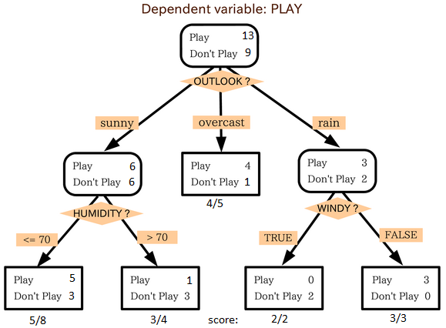

Slide 19
Training
The process of determining the ideal parameters comprising a model.

Slide 20
Weight
A coefficient for a feature in a linear model, or an edge in a deep network. The goal of training a linear model is to determine the ideal weight for each feature. If a weight is 0, then its corresponding feature does not contribute to the model.

Slide 21
Unawareness (to a sensitive attribute)
A situation in which sensitive attributes are present, but not included in the training data. Because sensitive attributes are often correlated with other attributes of one’s data, a model trained with unawareness about a sensitive attribute could still have disparate impact with respect to that attribute, or violate other fairness constraints.

Slide 22
Classification
A sub-category of Supervised Learning, Classification is the process of taking some sort of input and assigning a label to it. Classification systems are usually used when predictions are of a discrete, or “yes or no” nature. Example: Mapping a picture of someone to a male or female classification.

Slide 23
Classification Model
A type of machine learning model for distinguishing among two or more discrete classes. For example, a natural language processing classification model could determine whether an input sentence was in French, Spanish, or Italian.

Slide 24
Categorical Data
Features having a discrete set of possible values.
For example, consider a categorical feature named house style, which has a discrete set of three possible values: Tudor, ranch, colonial. By representing house style as categorical data, the model can learn the separate impacts of Tudor, ranch, and colonial on house price.
Sometimes, values in the discrete set are mutually exclusive, and only one value can be applied to a given example.
For example, a car maker categorical feature would probably permit only a single value (Toyota) per example. Other times, more than one value may be applicable. A single car could be painted more than one different color, so a car color categorical feature would likely permit a single example to have multiple values (for example, red and white).

Slide 25
Discrete Feature
A feature with a finite set of possible values. For example, a feature whose values may only be animal, vegetable, or mineral is a discrete (or categorical) feature.

Slide 26
Continuous Feature.
A floating-point feature with an infinite range of possible values. An example of a continuous variable would be the number of miles that a car has driven in its lifetime.

Slide 27
Supervised Learning
Where a program is “trained” on a pre-defined dataset. Based off its training data the program can make accurate decisions when given new data. Example: Using a training set of human tagged positive, negative and neutral tweets to train a sentiment analysis classifier.

Slide 28
Unsupervised Learning
Where a program, given a dataset, can automatically find patterns and relationships in that dataset. Example: Analyzing a dataset of emails and automatically grouping related emails by topic with no prior knowledge or training which is also known as the practice of clustering.

Slide 29
Regression
Another sub-category of supervised learning used when the value being predicted differs to a “yes or no” label as it falls somewhere on a continuous spectrum. Regression systems could be used, for example, to answer questions of “How much?” or “How many?”.

Slide 30
Decision Trees
A decision tree is a decision support tool that uses a tree-like graph or model of decisions and their possible consequences. A decision tree is also a way of visually representing an algorithm.

Slide 31


Slide 32
